Slide 1

Video #3
HARDWARE - 2
BEGINNER TO EXPERT GUARANTEED
ULTIMATE IT COURSE
ACCESS NETWORKING COURSE PLAYLIST LINK IN DESCRIPTION
SUBSCRIBE!!!

Slide 2
Answers:-
1. RAM is a Component? (Peripheral/Component)
2. TV Remote is an Input Device ? (Input/Output)
3. Apple iphone is a type of Micro Computer ? (Mini/Micro/Workstation)
4. Which Computer is used high calculation ? (Workstation/Super)
5. Does Laptop really need DVD Writer to Run ? (Yes/No)

Slide 3
Peripherals?
Peripherals are those Hardware items which are Hard, Visible & Touchable. The Hard Components of a computer system which are used by User. The Peripherals which are usually popular is like – Mouse, Keyboard & Monitor etc.

Slide 4
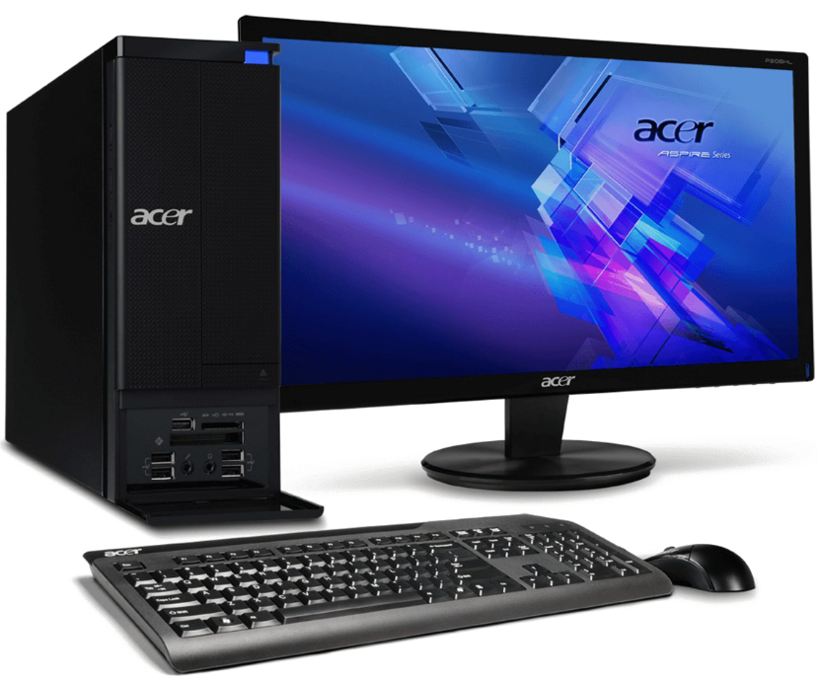
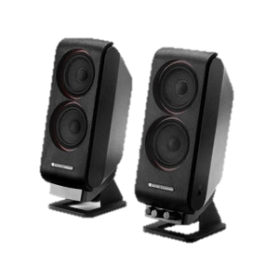

Slide 5
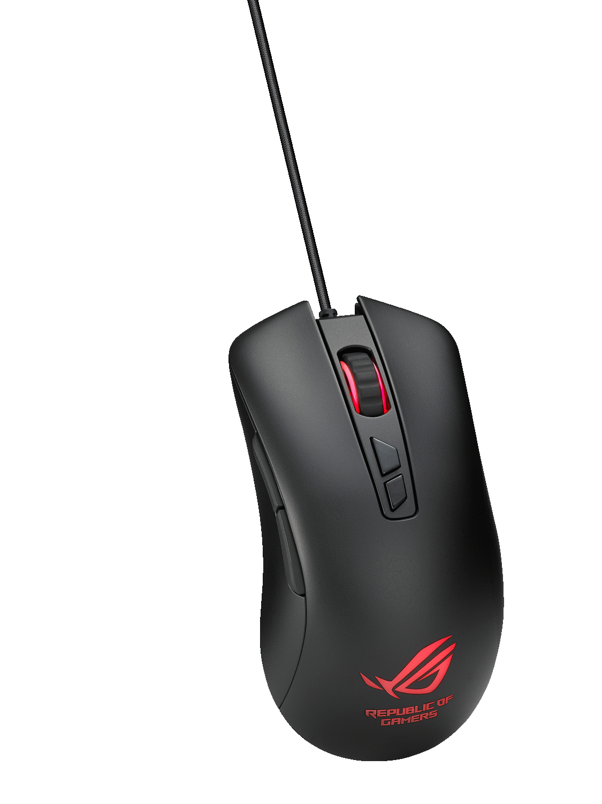
What is Mouse?
A Mouse is a Input Device used to Input in Computer System using a Pointer Arrow
There are 5 Basic Types of Mouse are:-
Mechanical Mouse
Trackball Mouse
Optical mouse
Wireless Mouse
G-Stick Mouse
Connectors – PS2 & USB

Slide 6
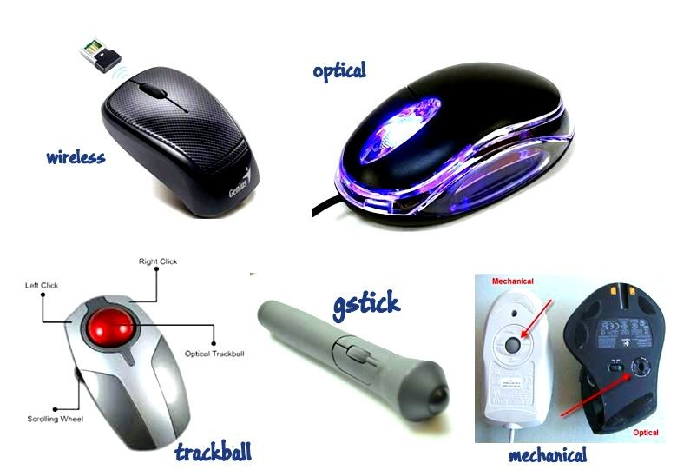
Mechanical Mouse
Trackball Mouse
Optical mouse
Wireless Mouse
G-Stick Mouse

Slide 7
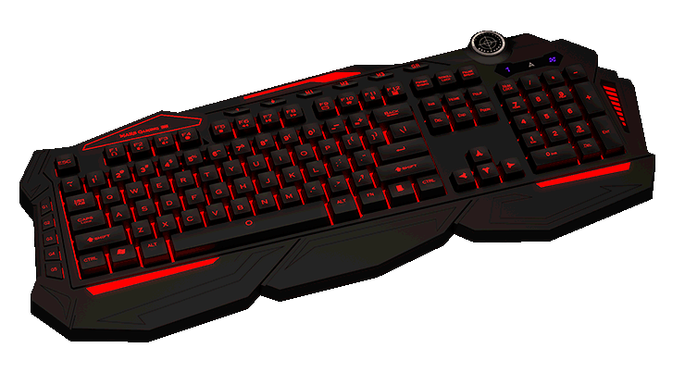
What is Keyboard?
A Keyboard is a Input Device used to Input in Computer System using some Key Strokes.
There are 5 Basic Types of Keyboards:-
Mechanical Keyboard
Gaming Keyboard
Standard Keyboard
Wireless Keyboard
Multimedia Keyboard
Connectors – PS2 & USB

Slide 8
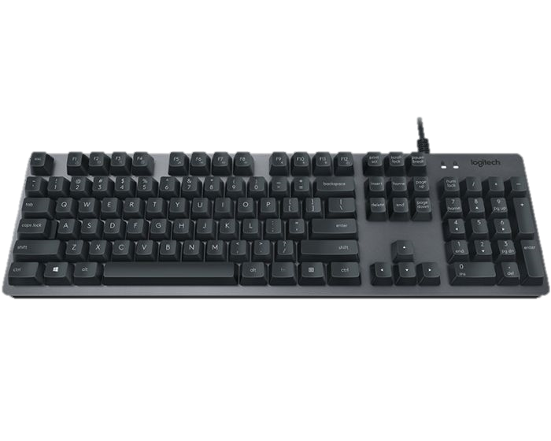
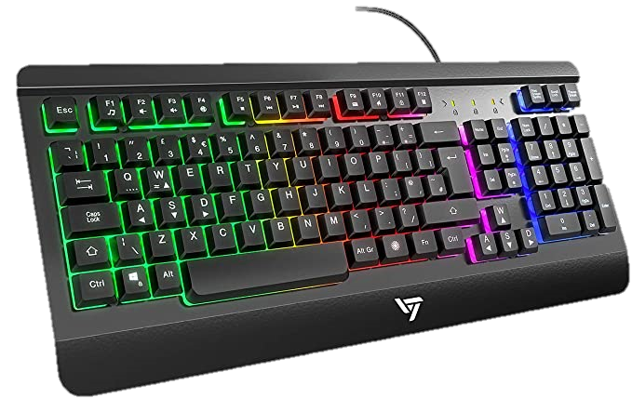
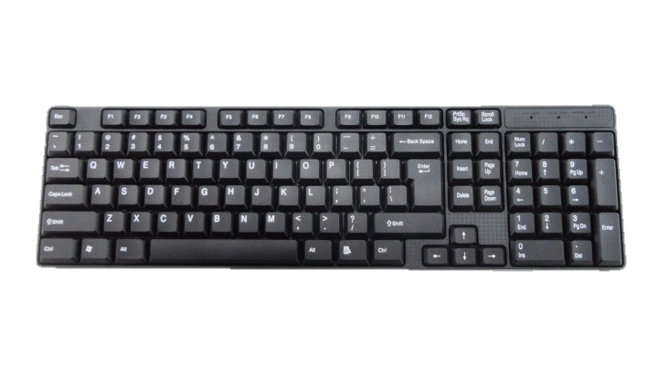
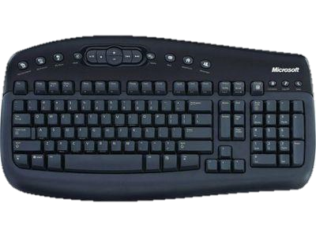
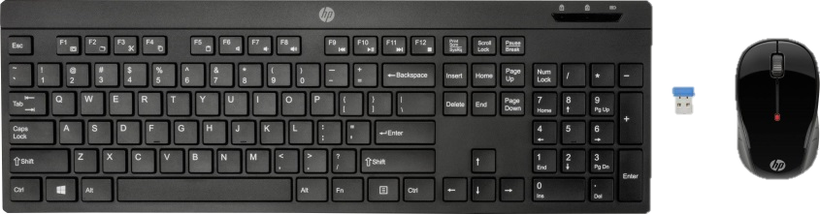
Gaming
Mechanical
Mechanical Keyboard
Gaming Keyboard
Standard Keyboard
Wireless Keyboard
Multimedia Keyboard
Standard
Multimedia
Wireless

Slide 9
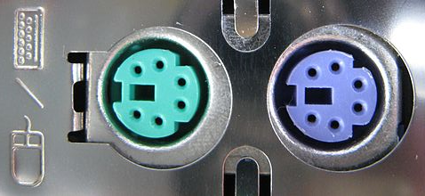
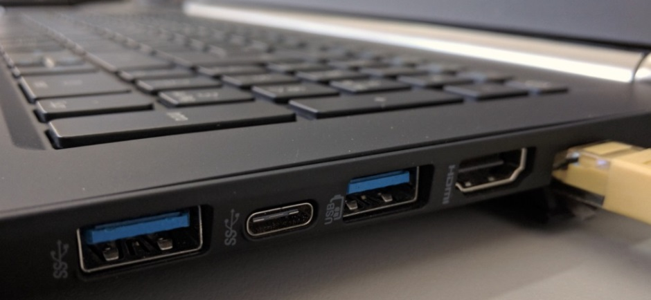
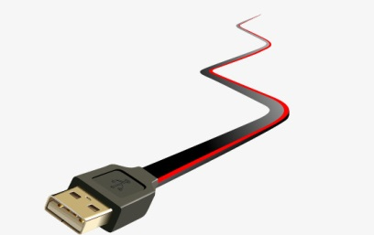
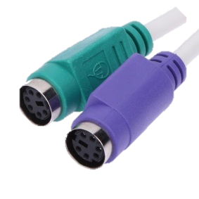
TYPES OF SUPPORTED PORTS?
PS2
USB

Slide 10
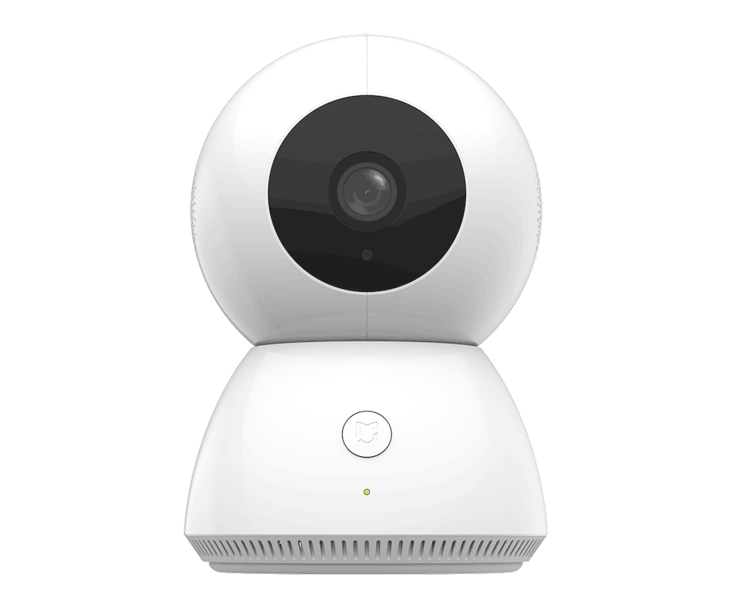
What is Webcam?
A Webcam is a Input Device used to Input Videos in Computer System using a Camera.
There are 3 Basic Types of Webcam are:-
Stand-alone Webcam
Integrated Webcam
Webcam with Microphone
Connectors – USB & Wireless

Slide 11
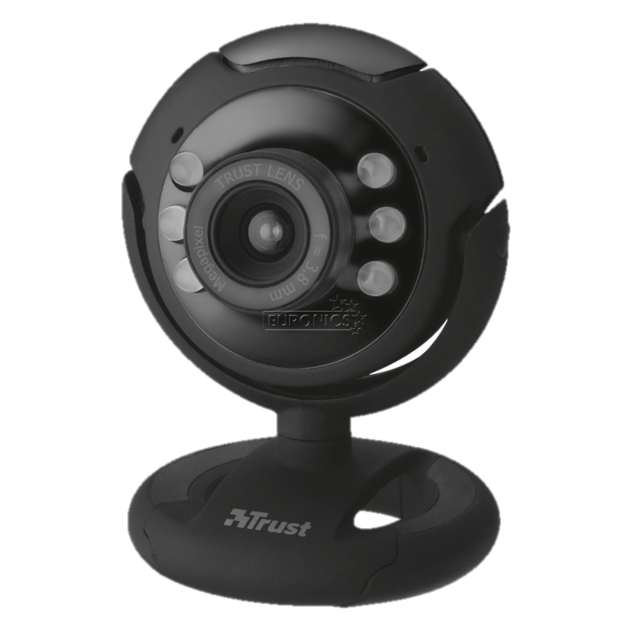
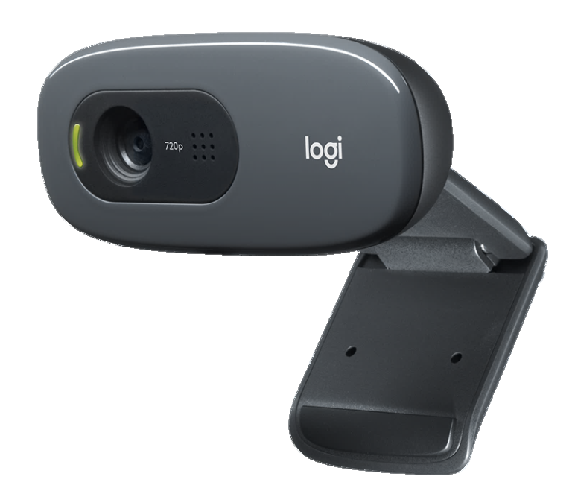
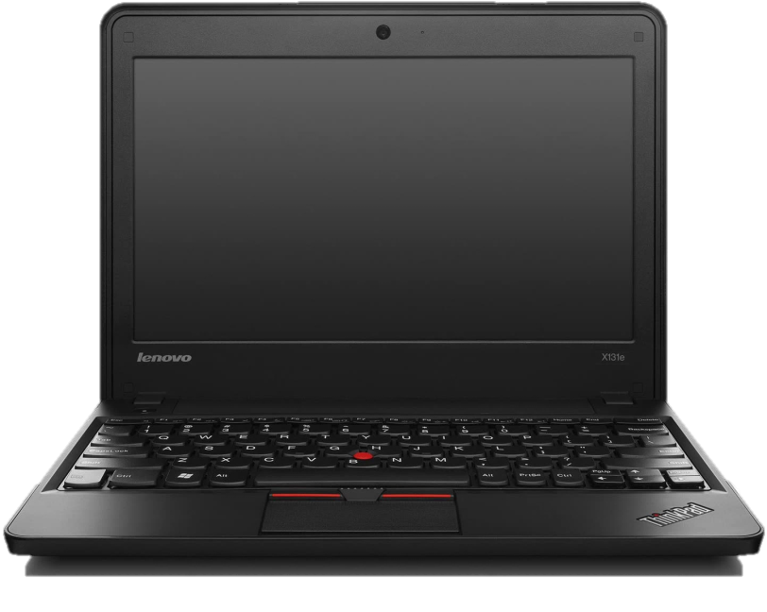
Standalone Integrated WithMicrophone

Slide 12
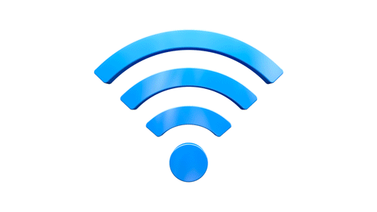
TYPES OF SUPPORTED PORTS?
WiFi
USB

Slide 13
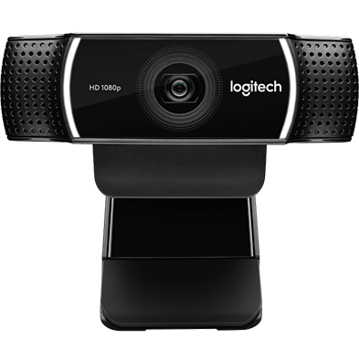
WEBCAM
Video Conferencing
Live Video
Take Pictures
Online Sessions
Technical Support
Video Calls

Slide 14
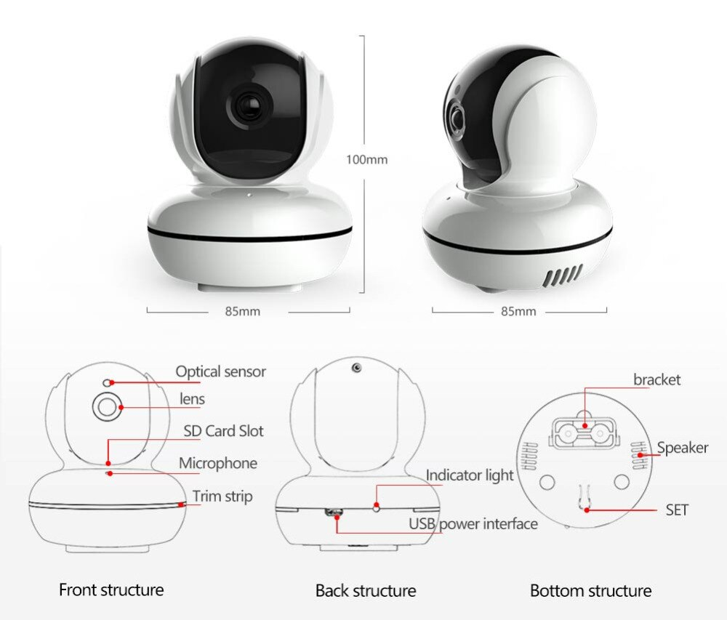
Form Factors
Camera Sensor
Resolution
Pixel Size
Visiontype
Angle Stablization

Slide 15

What is Microphone?
A Microphone is an Input Device used to Input voice in Computer System using small mic
There are Many Types of Microphone are:-
We are Considering a simple Microphone
Connectors – Audio Jack

Slide 16
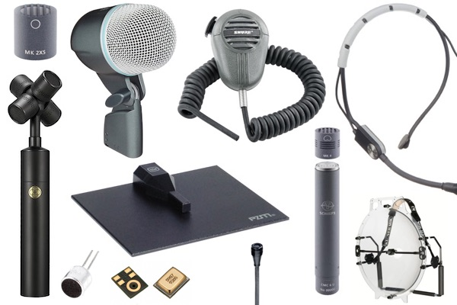
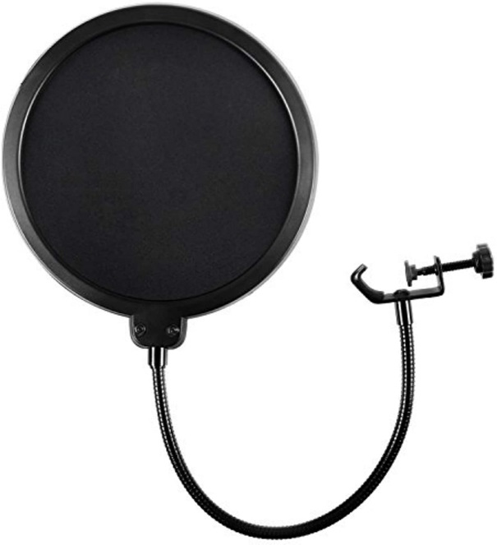

Slide 17
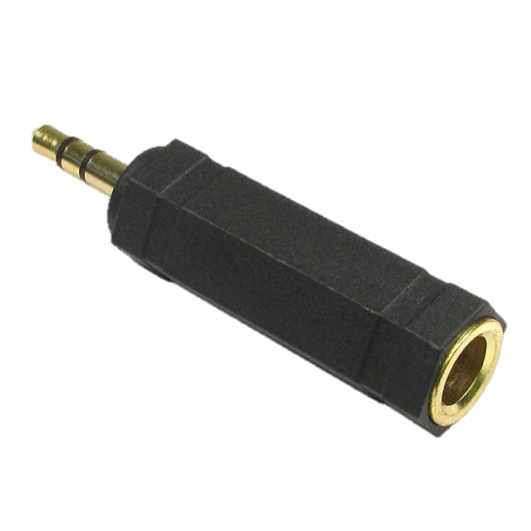
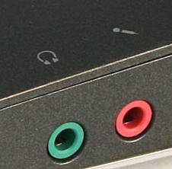
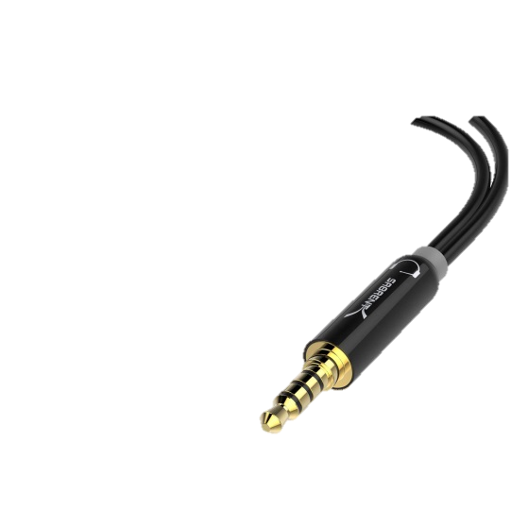
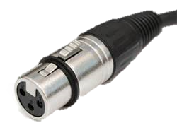
TYPES OF SUPPORTED PORTS?
Audio Mic Jack
XLR Stereo Jack

Slide 18
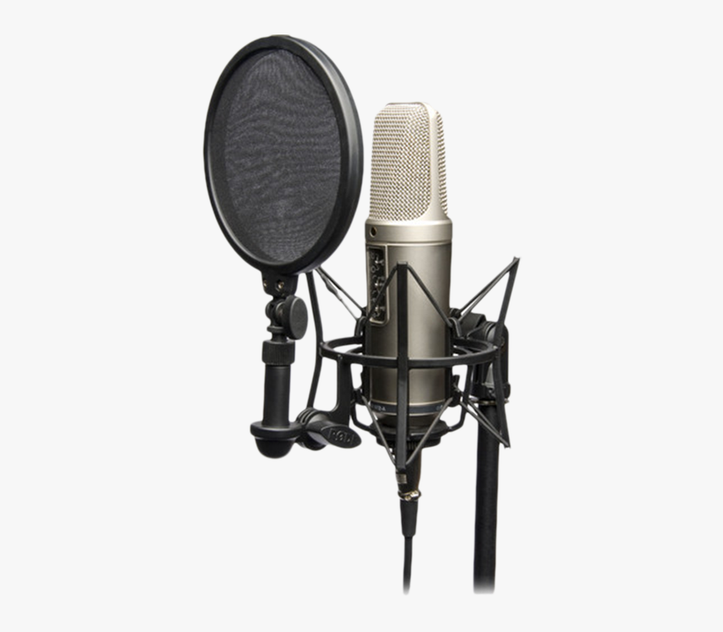
MICROPHONE
Video Conferencing
Audio Recording
Online Sessions
Content Production
VoIP Interaction
Song Recording

Slide 19
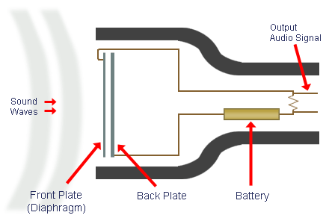
Form Factors
Diaphragm
Magnet or Battery
Pop Filter
Condenser
Noise Cancelation

Slide 20
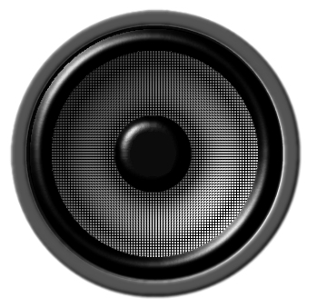
What is Speaker?
A Speaker is a Output Device used to Output Audio in Computer System using a Woofer.
There are 3 Basic Types of Speaker are:-
Theatre Based Speakers
Integrated Speakers
Wireless Speakers
Connectors – Wireless & Audio Jack

Slide 21
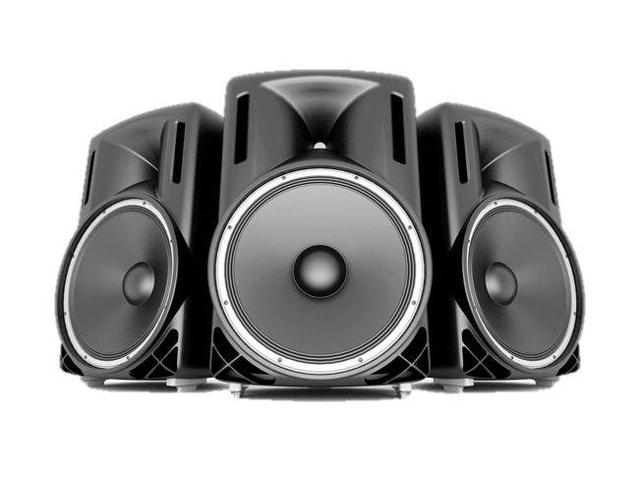
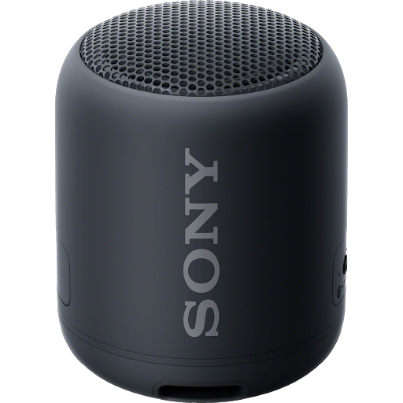
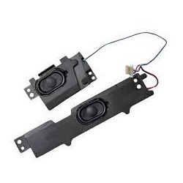
Theatre-Based Integrated Wireless

Slide 22

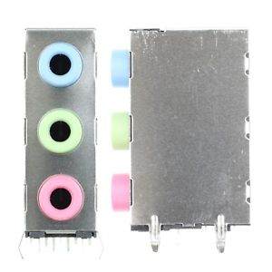
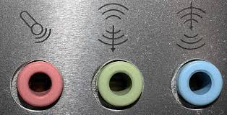
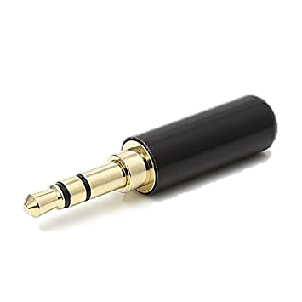
TYPES OF SUPPORTED PORTS?
Bluetooth
Audio Jack

Slide 23
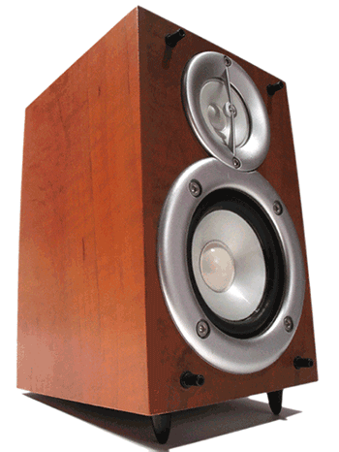
SPEAKERS
Listening Videos and Audios
Enhance Gaming Experience
Music Production
Conference, Education & Meetings
Video or Voice Calls

Slide 24
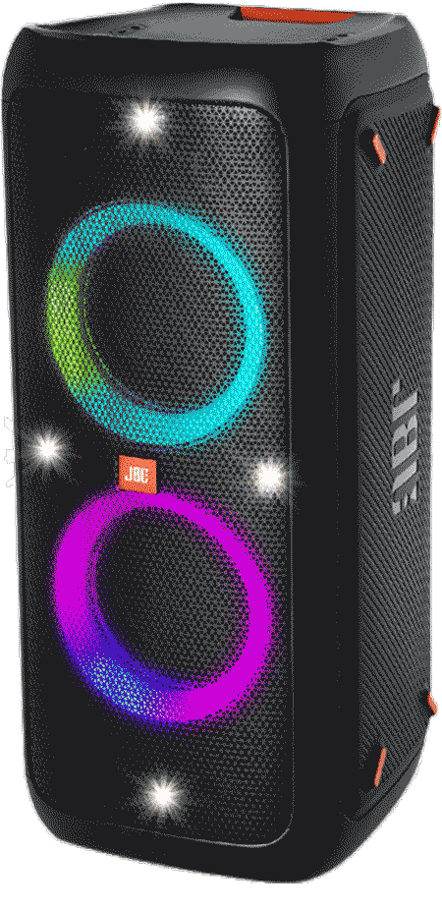
Form Factors
Bass
Treble
Frequency
kbps
Signals

Slide 25
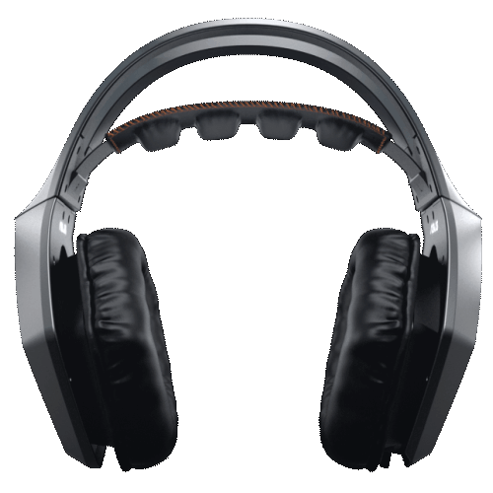
What is Headphone?
A Headphone is a Output Device used to Output voice in Computer System using lite Speakers
There are Many Types of Headphone:-
We are Considering a simple Headphone
Connectors – Audio Jack & Wireless

Slide 26
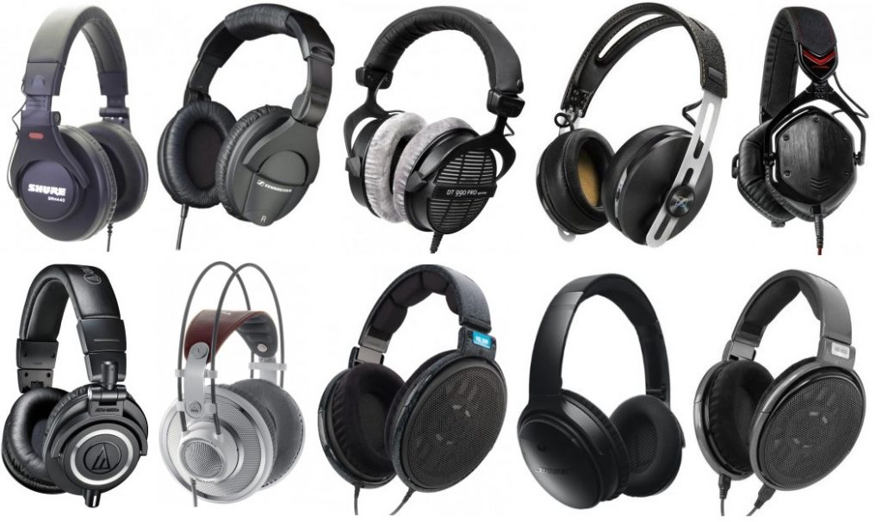

Slide 27
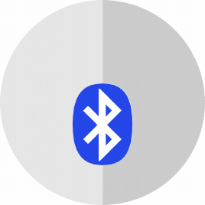
TYPES OF SUPPORTED PORTS?
Headphone Jack
Bluetooth

Slide 28
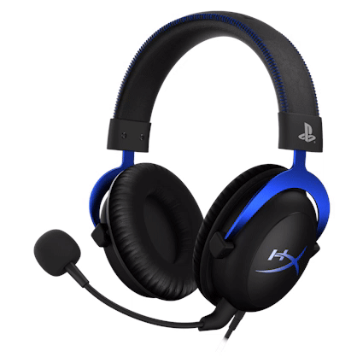
HEADPHONE
Video Conferencing
Gaming
No Disturbance
VoIP Interaction
Song Production

Slide 29

What is Monitor?
A Monitor is an Output Device used to display the output as result.
There are 5 Basic Types of Monitors :-
1. CRT – (Cathode Ray Tube)
2. LCD – (Liquid Crystal Display)
3. LED – (Light Emitting Diode)
4. TFT – ( Thin Film Transistor)
5. AMOLED – (Active Matrix Organic Light Emitting Diode)

Slide 30


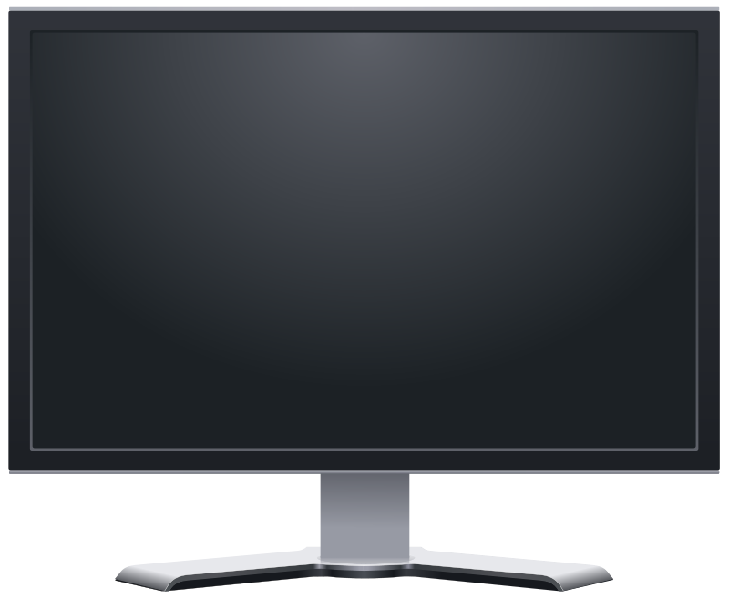
MONITORS
CRT – Cathode Ray Tube
These are the most heaviest and old generation monitors. There is an electron gun inside which emits RGB color electrons using vaccum tube and those electrons strikes in the fluricent or phosphor screen and form image.
LCD – Liquid Crystal Display
These are second generation monitors. Which were designed with flat panel and thin body and it forms image by using mirror, glass filter, electrode & liquid.

Slide 31
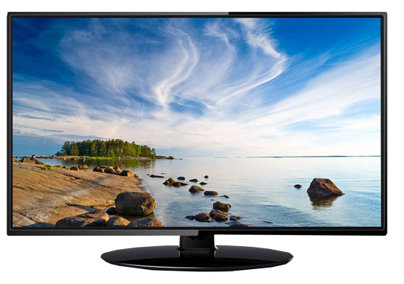
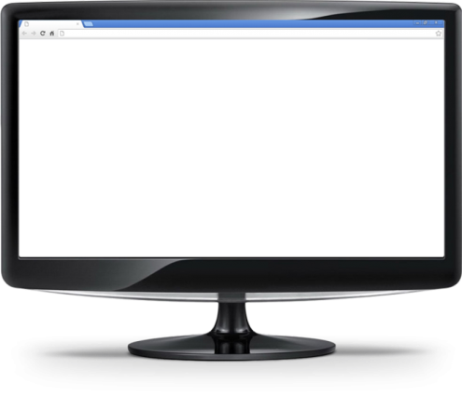
MONITORS
LED – Light Emitting Diode
These are the most using monitor type which are designed with sleek and stylish body and low power consumption. It make images by using electrode, glass filter and RGB Led lights.
TFT – Thin Film Transistor
It is the next generation LCD type monitor. In TFT each pixel is controlled by transistors. These have high refresh rate and high properties for generating better images.

Slide 32

MONITORS
AMOLED – Active Matrix Organic Light Emitting Diode
It is the type of OLED. This is the most advanced type of monitors which uses organic LED components to display the output. It makes the result colourful & vibrant. Basically these are used in Expensive mobiles and Curved TVs etc.
SAMOLED
DAMOLED

Slide 33
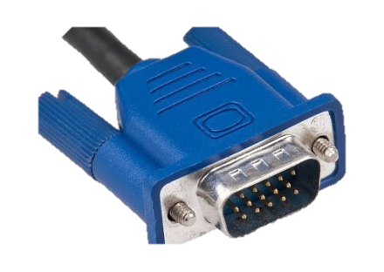
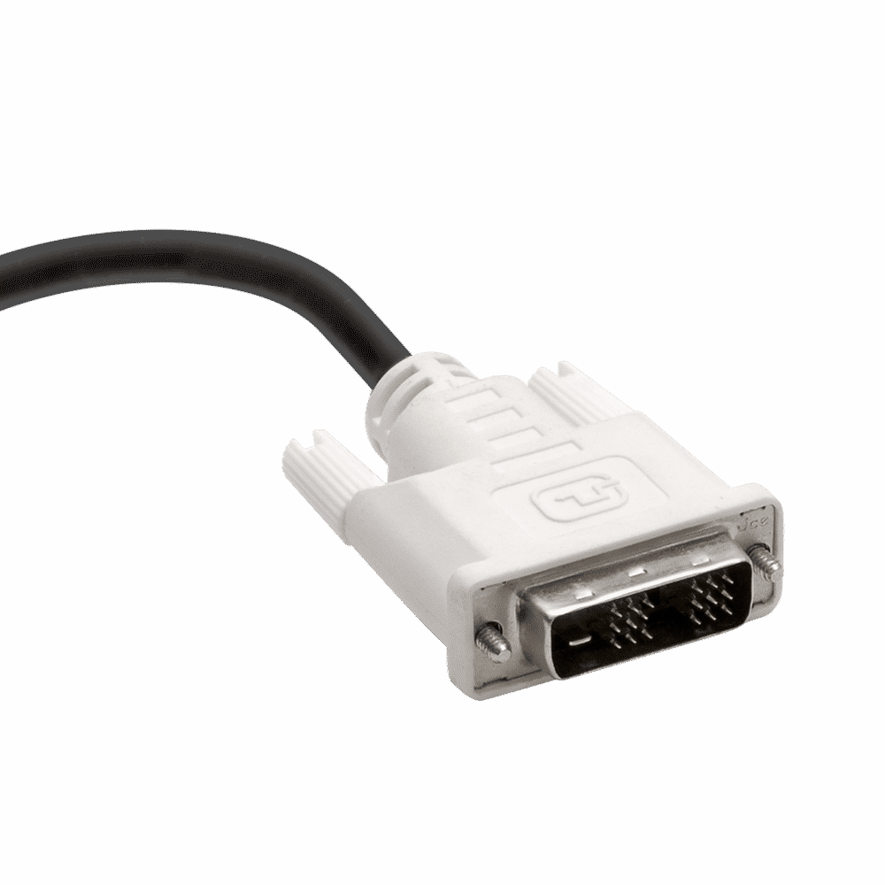
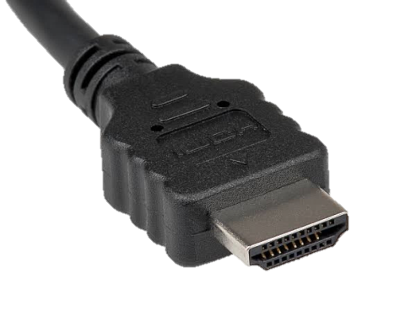
Types of Connectors in Monitors
1. VGA – (Video Graphics Array)
15 pins Only VIDEO
2. DVI – (Digital Video Interface)
24 pins VIDEO & AUDIO
3. HDMI – (High Definition Multimedia Interface)
19 pins HD VIDEO & AUDIO

Slide 34
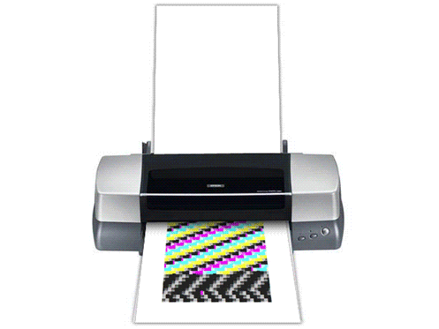
What is Printer?
A Printer is an Output Device which converts the Soft copy into Hard copy. It converts Digital copy into Physical Copy.
There are 2 Basic Types of Printer are:-
Impact Printers
Line Printer
Character Printer
Non-Impact Printer
Page Printer
Character Printer

Slide 35
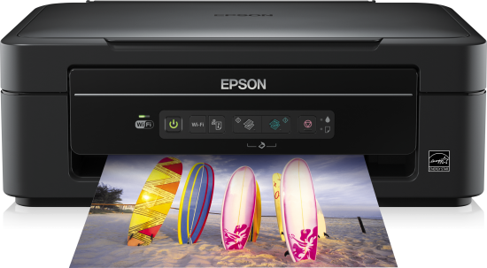
Types of Printers :-
Impact Printer :- Impact Printers are those
Printers which have physical contact between the print head, ribbon on
Cartilage and Paper.
2. Non-Impact Printer :- Non-Impact Printers are those
Printers which do not have physical contact between the print head, ribbon
Cartilage and Paper.

Slide 36

Character Printer :- Those Printer Which Print Paper Character Wise ex. typewriter.
Line Printer :- Those Printer Which Print Paper Line Wise ex. Chain, Drum & Band
Page Printer :- Those Printer Which Print Whole Paper at a Time ex. Laser

Slide 37


Impact Printers
Dot-Matrix Printer
It has an array of pins which helps to print the paper with tiny Dots ex. Railway Ticket Printer. Speed up to 100 to 600 CPS having 9 to 24 Pins
Line Printer
They are used by Offices where they need to print data at large scale ex. Poster Drum Printer. Speed up to 1200 to 6000 LPM

Slide 38


Non-Impact Printers
Ink-Jet Printer
Ink-jet Printer is similar as Dot-Matrix but it doesn’t have any physical contact with External media. It gives Printout with the help of Spray Speed up to 250 CPS.
Laser Printer
Laser Printer Which uses Laser Beam and Heated Toner to produce Printout on a Paper. Speed up to 6000 to 12000 pages per hour

Slide 39


Thermal Printers
A Thermal Printer is one that uses heat to transfer an Impression into paper types of thermal printer
Thermal Wax Transfer Printer – Where a thermal print head melts ink and transfer with the help of ribbon onto paper. After cooling the wax is permanent ex. DTDC Bus Ticket
2. Direct Thermal – Where a printer prints the image by
burning dots onto a coated paper ex. Barcode Generator

Slide 40


Other Printers
Virtual Printer – A Virtual Printer is a simulated device whose user interface and API are similar to a printer driver, but the device is not connected with a physical printer ex. Microsoft XPS Document Writer, Cute PDF Writer
Multi Functional Device(MFD) – It is also known as
all in one Printer. This is a combination of various
functionalities like Printer, Scanner and Photocopy etc.
TIP -
Type SERVICES.MSC in cmd to show the running Printing processes also allow to restart and stop processess

Slide 41





Types of Connectors in Printers
Serial/Com Port – 9 & 25 pins connector
Parallel Port - 40 pins connector
USB Port – 4 pins connector
LAN Port – 8 pins connector
Wireless – without connector

Slide 42

What is Scanner?
A Scanner is an Input Device which converts the hard copy into soft copy. It converts Hard copy into Digital copy.
Types of Scanners :-
Specialized Scanner
Handheld Scanner
Standard Scanner (Flatbed & Sheet fed)
Scanning Applications

Slide 43


Specialized Scanner
Those Scanners which are used to scan some special documents like. Business card & Metro Card
Handheld Scanner
Those Scanners which are Smaller and easy to hand held and uses to scan a lot of things very quickly like. Barcode Scanner

Slide 44


Standard Scanner
Flatbed Scanner
In a Flatbed Scanner the Documents or pages are placed on the screen for scanning. These maybe standalone or integrated in a printer
Sheetfed Scanner
A Sheetfed scanner is a smaller and Portable scanner in comparing of Flatbed You can scan a whole book using sheetfed scanner

Slide 45


Application Scanner
Those Scanners which need Mobile Phone to be Operate like CamScan & Genius Cam

Slide 46
Types of Connectors in Scanner
Serial/Com Port – 9 & 25 pins connector
Parallel Port - 40 pins connector
USB Port – 4 pins connector
LAN Port – 8 pins connector
Wireless – without connector

Slide 47

What is UPS?
A UPS is an Input Device used as Power backup when mains off.
An uninterruptable power supply (Ups) is a device that allows a computer to keep running atleast a short time .when primary power source is lost .It also provides protection from power fluctuation . Thus we can say that Ups is a device that helps to provide consistent power to computer system

Slide 48



Input
Battery Charger
Main AC
OUTPUT
When Main AC is ON
Battery
DC to Ac Inverter
(Block Diagram Of Ups)
When Main AC is Present, it provides power to DC Supply Of inverter Section as well as charges the battery simultaneously .

Slide 49

Advantages of UPS
Less Interruption
No Data loss
Enhance Components Health
Good for Emergency Time
Prevent Crash

Slide 50
Questions:-
1. UPS inputs ___________ Current ? (AC/DC)
2. ________ Keyboard is ideal for story writers ? (Multimedia/Mechanical/Gaming)
3. Abbrevation of PS2 is _________? (Play Station/Personal System)
4. List five popular brands of Printer?
5. Pink Audio port is for ___________? (Speakers/Headphone/Microphone)
Solve all question and comment down answers...

